Slide 1


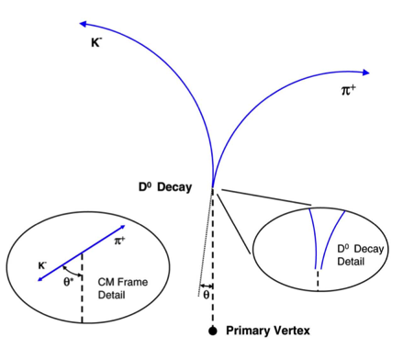
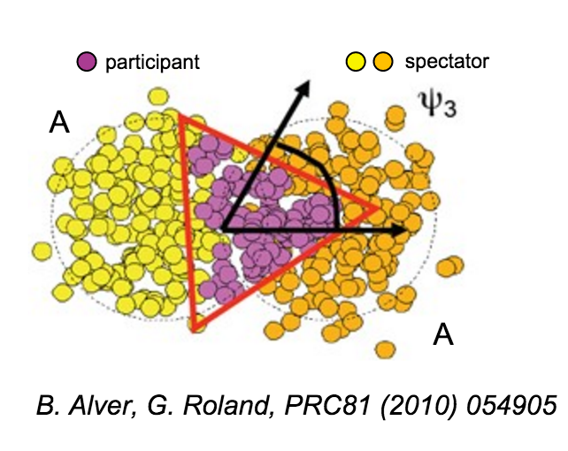
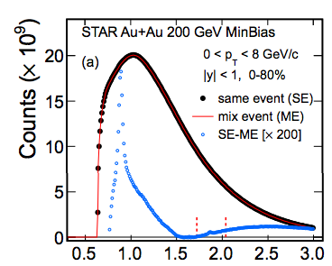
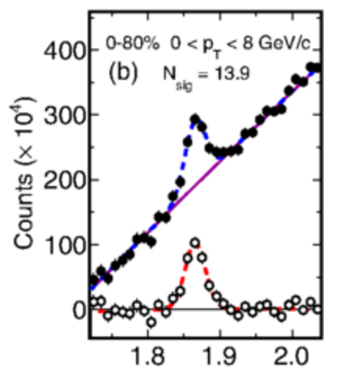
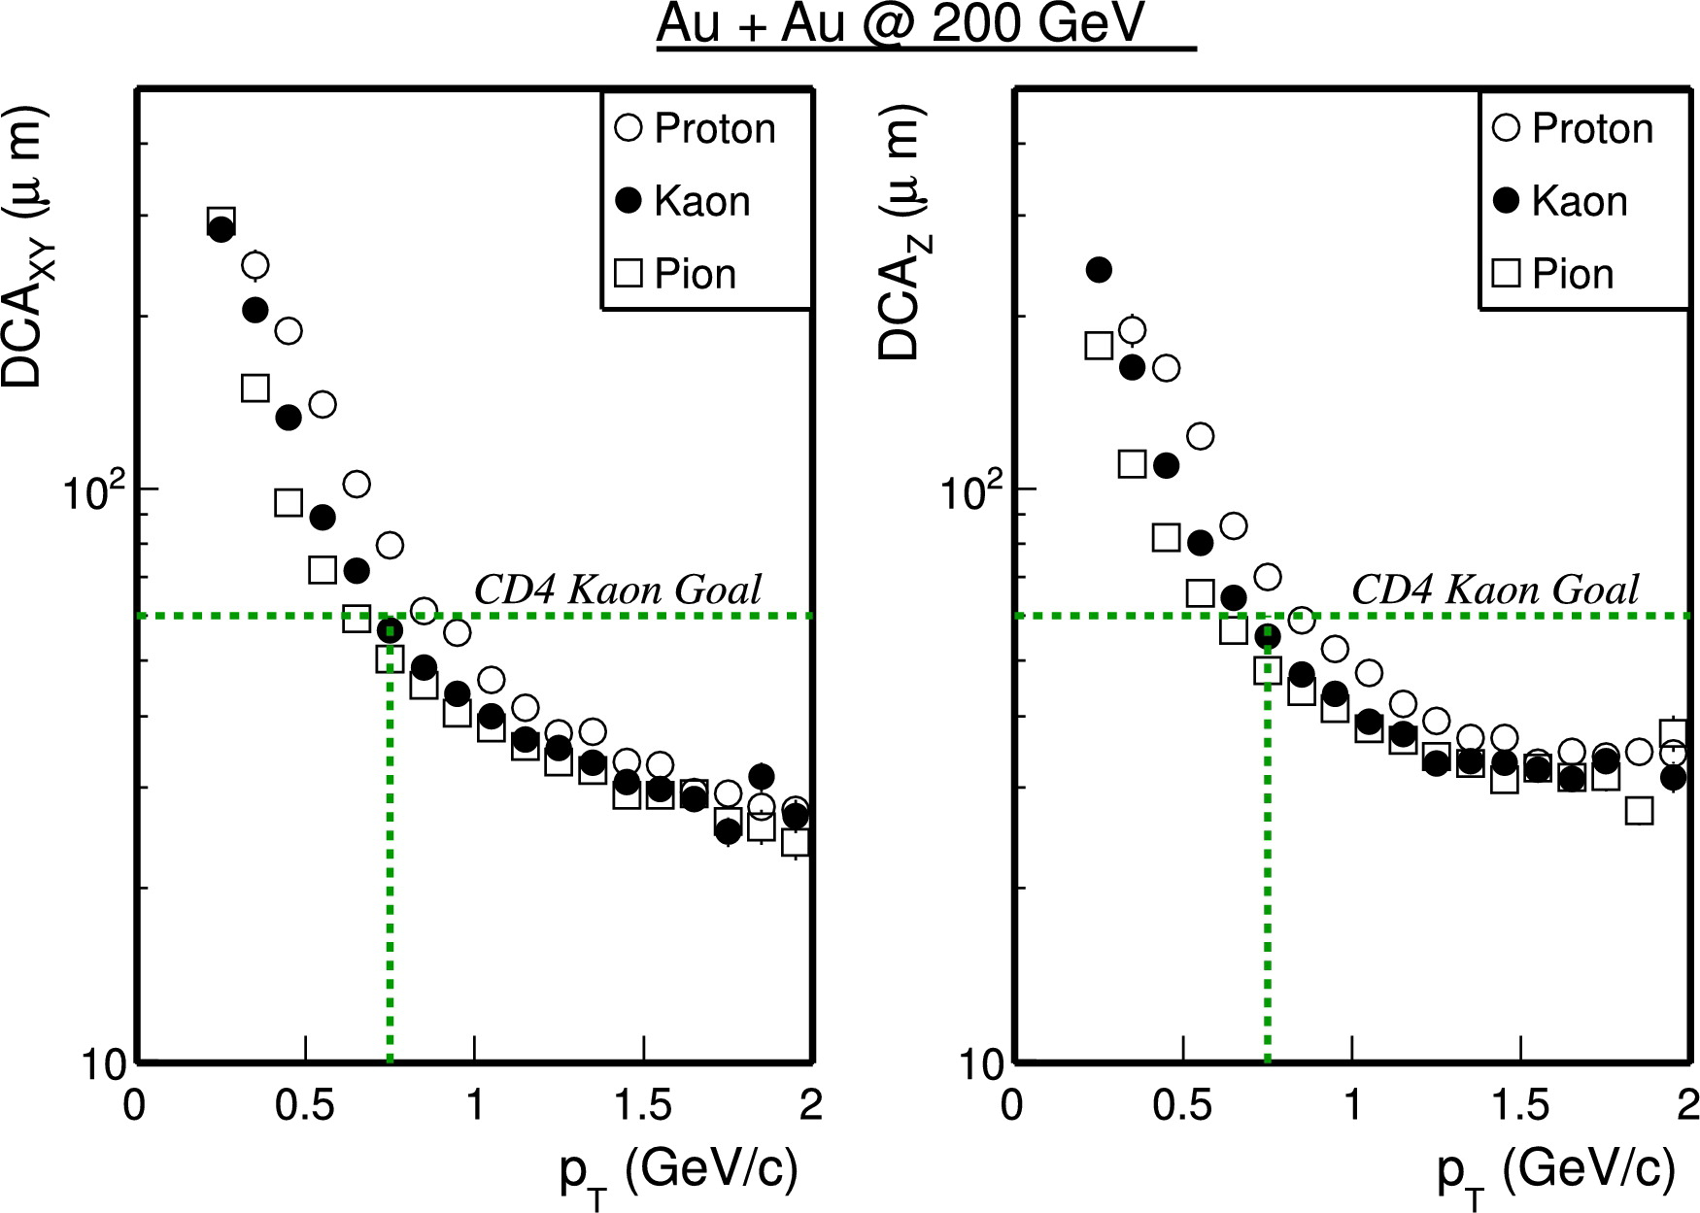


Centrality and p_{T} dependence of D⁰ triangular flow in Au+Au collisions at √s_{NN}=200 GeV
Michael Lomnitz, for the STAR Collaboration
Lawrence Berkeley National Laboratory
Abstract: Heavy quarks are produced through initial hard scatterings in heavy-ion collisions, and are affected by the hot and dense medium throughout its evolution when propagating in the medium. Several models have predicted that fluctuations in the initial conditions, together with frequent interactions with the QGP medium could lead to a finite triangular flow (v₃) for the D⁰ meson.
We present the first measurement of the D⁰ triangular flow using data taken with the STAR Heavy Flavor Tracker in Au+Au collisions at √s_{NN} = 200 GeV. The D⁰ v₃ will be compared to light hadron measurements as well as theoretical calculations. Physics implications on the charm-medium interactions as well as the QGP medium properties will be discussed.
Motivation
D⁰ Signal
Some models [1] predict that fluctuations in initial conditions and interactions between D⁰ and the medium could lead to a finite D⁰ v₃.
Models suggest that a QGP with higher temperature/ larger volume will transfer more bulk flow to heavy quarks.
This trend will be observable in comparing the centrality dependence of v₃/ε between light and heavy quarks.
The Heavy Flavor Tracker (HFT) was designed to detect heavy flavor particles through direct topological reconstruction of displaced vertices.
Using the HFT drastically reduces the combinatorial background by imposing cuts on the decay topology, e.g. the decay length and distance of closest approach (DCA) to the primary vertex.
Over an order of magnitude improvement in measured D⁰ signal significance compared to 2010/11 results using only the TPC [3].
With this improvement, the 2014 dataset is equivalent to roughly 200 billion events without the HFT.
 | w/o HFT | w HFT
 | 2010 + 2011 | 2014
# events(MB) analyzed | 1.1 B | ~900M
Significance per billion events | 13 | ~220
D⁰ → K⁻ π⁺ BR = 3.83 %, cτ ~ 120 μm
Λ_{c} → p K⁻ π⁺ BR = 5.0 %, cτ ~ 60 μm
B mesons → J/ψ + X or e + X cτ ~ 500 μm
STAR Heavy Flavor Tracker
2014 w/ the HFT
2010/2011 w/o the HFT
Detector | Radius (cm) | Hit Resolution R/ϕ - Z (μm - μm) | Radiation length
SSD | 22 | 20 / 740 | 1% X₀
IST | 14 | 170 / 1800 | <1.5 %X₀
PIXEL | 8 | 12/ 12 | ~0.5 %X₀
 | 2.8 | 8 / 8 | ~0.5% X₀
Azimuthal Anisotropy
The STAR HFT consists of three subassemblies with the purpose of gradually improving the track pointing resolution to be able to distinguish decay vertices.
SSD: the Silicon Strip Detector consists of a single layer of double-sided silicon strips sensors. Existing detector with new, faster electronics (200 Hz --> 1 kHz).
IST: the Intermediate Silicon Tracker consists of a single layer of single-sided silicon pad sensors. Like the SSD, it guides tracks from the TPC to the PiXeL detector.
PiXeL detector: the heart of this upgrade. The goal of this detector is to measure hit points with great accuracy to find secondary decays. It is made by 2 layers of 20.7 μm x 20.7 μm CMOS Monolithic Active PiXeL sensors [2].
STAR Preliminary
D⁰ v₂ follows the same Number of Constituent Quark (NCQ) scaling as is observed for light hadrons [5] , indicating that charm quarks have achieved local thermal equilibrium.
Indication that D⁰ v₃ is non-zero at RHIC.
The right panel shows the v₃/NCQ^{3/2} vs. (m_{T}-m₀)/NCQ with m_{T} = √(p_{T}² + m₀²), as suggested in [4], showing a consistent trend between D⁰ and light hadrons.
The right figure shows the measurement of D⁰ triangular flow in 10-40% central Au+Au collisions at RHIC.
The model prediction [1] includes charm interactions with the QGP medium and fluctuations in the initial conditions.
Measurements in 0-10% and 40-80% centralities are limited by statistics.
STAR Preliminary
The figure on the right shows the single track pointing resolution in the transverse (xy) and beam directions (z) for three particle species.
HFT exceeds the design goal (green line), with a track pointing resolution below 55 μm for 750 MeV/c Kaons.
HFT Performance
Summary and Outlook
First results of D⁰ v₃ using the HFT. Both v₂ and v₃ appear to follow the same NCQ scaling observed for lighter particle species.
D⁰ v₃ is non-zero, suggesting the importance of fluctuations in initial conditions.
Two billion events recorded in 2016 will further improve the precision for D⁰ measurements and will allow more thorough studies:
Centrality dependence of D⁰ v₂ and v₃ .
Studies of other charmed hadrons (Λ_{c}, D_{s}, …) and bottom hadron flow
STAR Preliminary
References:
[1] Nahgrang M. et al, Phys. Rev. C91 014904
[2] E. Anderssen et al. , A Heavy Flavor Tracker for STAR (http://rnc.lbl.gov/hft/docs/hft_final_submission_version.pdf) [3] L. Adamczyk et al. (STAR Collaboration), Phys. Rev. L113 142301
[4]: R. Lacey (PHENIX Collaboration), Journal of Phys. G38 124048
[5]: L. Adamczyk et al. (STAR Collaboration), arXiv:1701.06060
The STAR Collaboration
drupal.star.bnl.gov/STAR/presentations

